Slide 1
Introduction to Microsoft Flow
Microsoft Flow Overview
Creating My First Flow

Slide 2
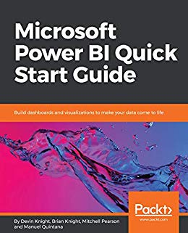
Hello, my name is…
Manuel Quintana
Training Content Manager
Co-Author -
mquintana@pragmaticworks.com
Blog: https://sqlrican.wordpress.com/
Twitter: @SQLRican

Slide 3
Requirements
Permission Needed
Access to create Microsoft Flows
Free license or Community Edition
Access to upload files to OneDrive for Business
Access to create and write to a SharePoint List
Access to Twitter
Technologies Used
Microsoft Flow
SharePoint
OneDrive for Business
Twitter
The Internet
Microsoft Windows XP Professional, Microsoft
Windows 7, Microsoft Windows 8, Windows 10

Slide 4
Agenda
Microsoft Flow Overview
Using Flow Templates
Creating Your First Flow From Scratch
Designing Approval Flows
Notes:
First, we’re going to go over what a power bi dataflow is, who uses dataflows, and why you would use dataflows to begin with.
We’re going to cover creating and using dataflows as well as the extensibility of Azure products in combination with Dataflows.
We’ll also be going over some best practices, tips, and tricks when it comes to using Dataflows.

Slide 5
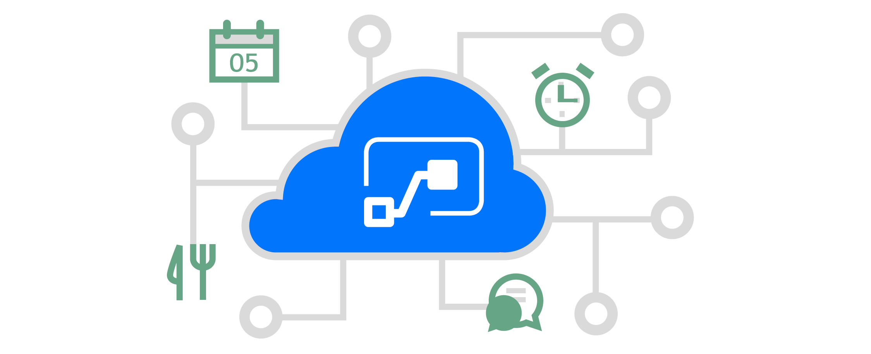
Flow is…
Workflow automation
Routine and Repetitive tasks
Flow is a global-scale cloud-based SaaS application that supports the digital transformation of processes
Notes:
Gaps in data preparation process
Need for standardized ETL
Need for Re-usable data
Need for greater extension of data capabilities

Slide 6
Why Automation?
Increase Productivity
Eliminate Inconsistencies
Focus on Business Critical Issues
Notes:
Dataflows bridge the data prep gap
Standardized ETL
Re-usable & Extensible
Power Query for the web
“Self-service data warehousing”
Leverages the cloud
Leverages ADLSv2 & CDM

Slide 7
Business Problems, Flow Solutions
Work Force Multiplication
Nontechnical staff acts as citizen developers
Leveraging drag and drop functionality, not code
Systems Integration
225+ Connectors
Custom and template solutions
Regulation
Administration & compliance
Data Loss Prevention (DLP) policy
Notes:
Powerful and flexible
Includes MS and non-MS connectors (eg. SalesForce, social media, etc.)
Flow allows you to setup a

Slide 8
Real World Use Cases Within Power Platform
Power BI
Power Apps
Microsoft Flow
Notes:
Addit6ional Example of how Flow works within the PowerPlatform
-A business user may develop an app using PowerApps designed to submit expense reports
-Once an expenses is submitted this app then leverages Microsoft Flow to send notification to those that need to approve each expense
-Then Power BI is used to surface this data into reports and dashboards for analysis.
Examples:
I may post a travel time of my location to Microsoft Teams with a button
Send an update with meeting notes about sales goals every 5th day of month
Save email attachments from your boss automatically to a SharePoint list

Slide 9
Flow’s Audience
Flow focus:
Business Users & Specialists
(Office, Dynamics)
Logic Apps Focus
IT Pro / Developers
(Visual Studio, Azure)
Notes:
This set of tools is designed for rapid development
Not limited to developers
Powerful, point-and-click approach to building solutions
Easy for anyone familiar with Microsoft Office to create full scale solutions that would previously have been reserved for the IT staff to develop.
Common Data Service: Business Process Flows
Data Modeling
Create custom entities, attributes, relationships with other entities. Business rules for the data that run client and server side. Sophisticated security model providing row level security and even models hierarchies.
Business logic
Business process and workflow include conditions, branching and custom actions including sending emails or creating other records.
User interface
Pattern-based metadata-driven UI automatically generated. UI includes forms, lists with customizable views and more.

Slide 10
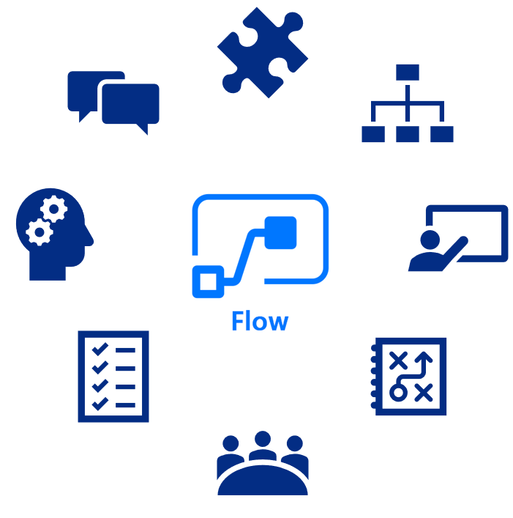
Extended Benefits
IT/Developers
Highly advanced and business critical Flows
Logic Apps
Any Flow can be converted to a Logic App
Notes:
My Flows, Team Flows and Business Process Flows
Sometimes IT / devs need to take over when the Flow gets too advanced or becomes business-critical
Because Flow is built on Logic Apps, Logic Apps can do everything that Flow can
Any Flow can be converted to a Logic App
Enterprise developers may want to:
1. Develop custom connectors (for organization's data and web services)
2. Build Azure Functions (extend apps with custom server-side logic)
3. Embed Flow directly into website experiences (integrated – surfacing workflows or processes where people in your organization already do their work)
ISVs may want to:
Develop flows in a sandbox environment, and then move those flows to a test environment.
After testing, the ISV would then move the flows to a production environment for clients who purchase these flows
(Flows you create inside a solution are known as solution-aware flows. You can add multiple flows in a single solution.)

Slide 11
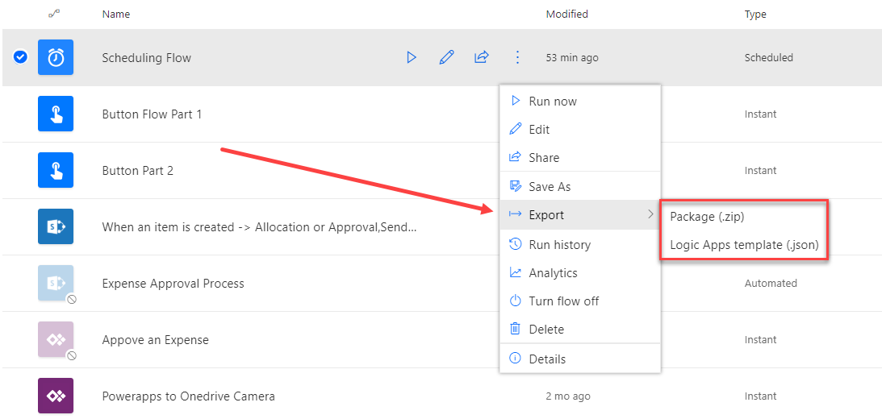
Exporting Flows
Export Options
Flows can be exported as a .zip file and migrated to another tenant
Flows can also be exported as a .json file, which allows you to upgrade Flows to Azure Logic Apps

Slide 12
Sharing Flows
Flows can be shared
Share flows with others as Owners or Run-Only users
Share flows via Web or Mobile
Invite users or entire O365 groups

Slide 13
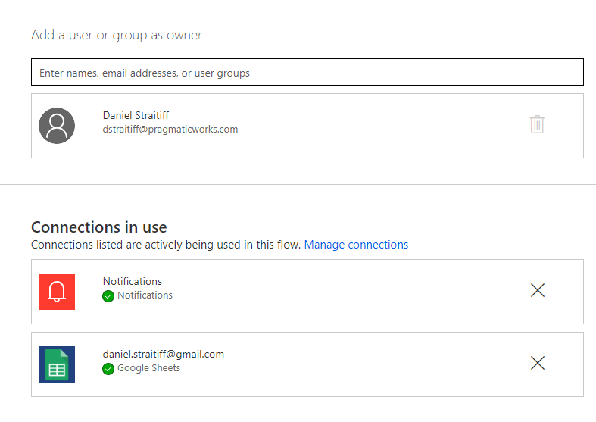
Flow Owners
Flow Owners
Owners can create, delete, and modify Flows
By default the Flow Creator is the Flow Owner
Flows can have multiple owners
My Flows vs Team Flows
When a Flow has multiple Owners it becomes a Team Flow and will appear in the Team Flows tab instead of My Flows tab

Slide 14
Run-Only Users
Run-Only Users
Can run the flow, but cannot manage, edit, or delete the flow
Can be added to flows with manual triggers, buttons, sharepoint, etc.
Run-Only Permissions
Can manage run-only users and their access to connections used within the flow

Slide 15
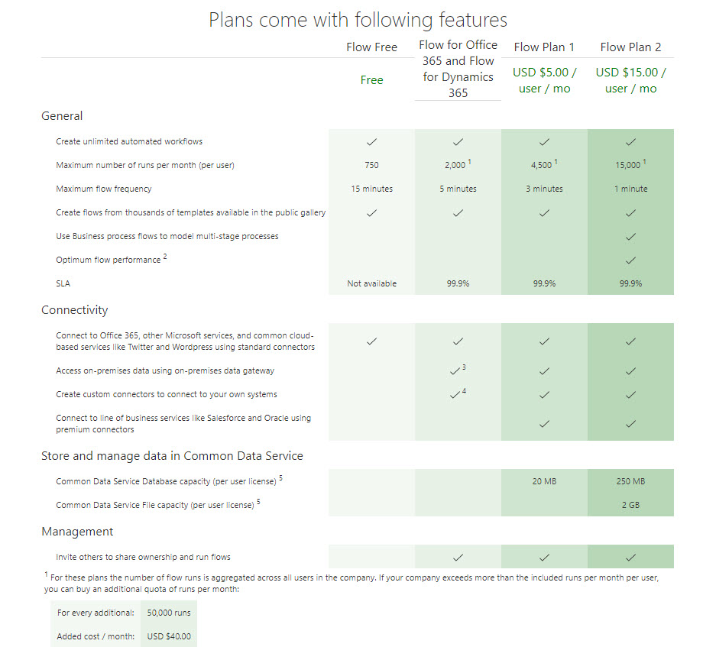
Look into the Licensing….
Notes:
https://flow.microsoft.com/en-us/pricing/

Slide 16
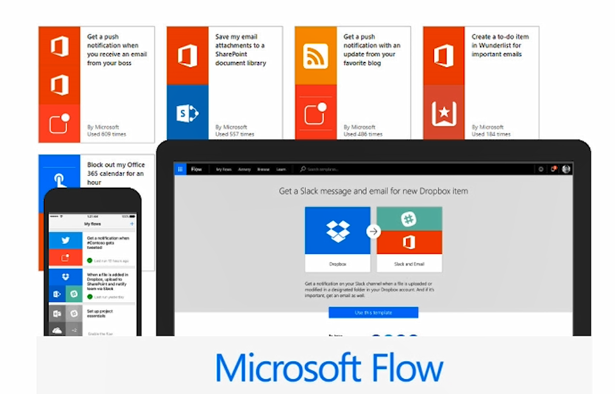
Let’s define a few terms…

Slide 17
Triggers & Actions
Triggers
Sets the flow in motion
An Event
A Button
Scheduled
Actions
What you want to happen when a trigger is invoked
Workflow Definition Language
Notes:
The trigger can be something like a new email arriving in your inbox or a new item being added to a SharePoint list (EVENT).
A BUTTON trigger runs tasks through manual action (simple push of a button) via mobile devices.
SCHEDULED triggers are based on predetermined times and frequencies.
Actions
E.g. An email trigger may start the action of creating a new file on OneDrive for Business. Other examples include:
Collecting or posting tweets
Receiving and starting approvals
Instantly responding to high-priority notifications or emails
Capturing, tracking, and following up with new sales leads
Copy all email attachments to your OneDrive for Business account
Collecting data about your business, and sharing that information with your team
Automating approval workflows

Slide 18
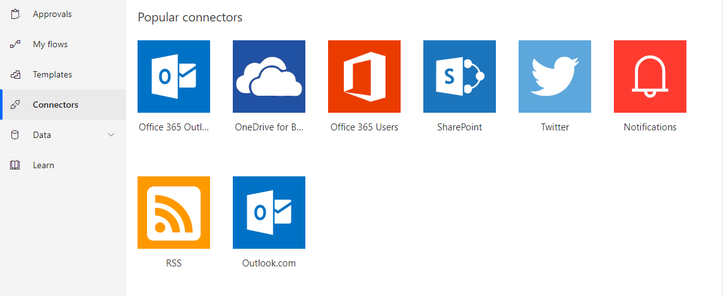
Connectors
What are Connectors?
Connections between services that can be used as triggers and actions in Flow
Must have an account for and be signed into services to utilize them
Some connectors are not available to free users (Premium)

Slide 19
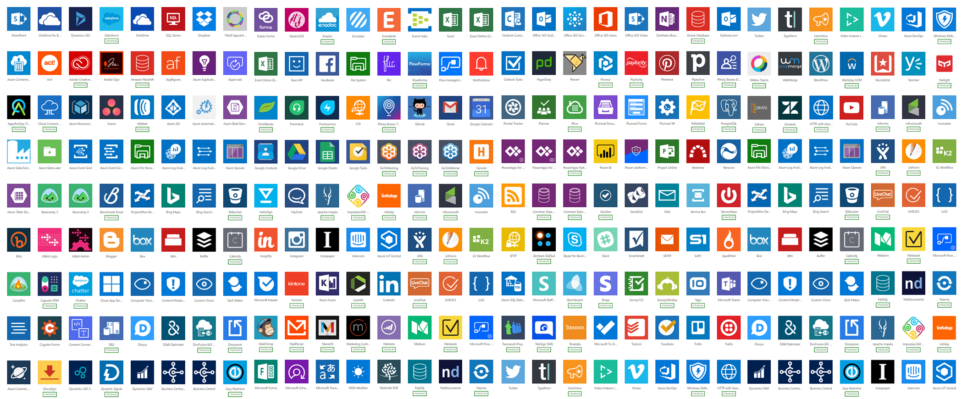
Connectors
Data Explorer

Slide 20
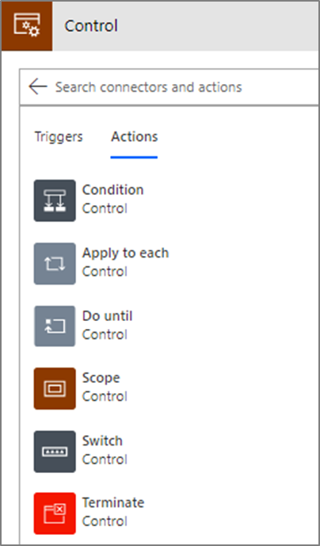
Controls
Controls
Actions to provide control-of-flow
CONDITION
SWITCH
Notes:
Core Action Categories include:
Control: actions to provide control-of-flow
Variables: actions to manage state within flow lifetime
Data operations: action to process data & prepare content

Slide 21
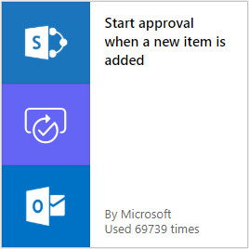
Flow Templates
What is a Template?
A pre-built flow that performs one or more tasks automatically after it is triggered by an event
Can be modified to fit your specific needs
Can be examined as a Learning Tool
Can be uploaded to the Microsoft Flow
Community for sharing

Slide 22
Templates, Templates and Templates
Notes:
Snapshot of Flow templates
Preconfigured triggers and actions based on common needs and uses

Slide 23
Event Flows
What is the Trigger?
Based on an event that occurs in another service
Example
When a new row is added to a SharePoint List then…

Slide 24
On-Demand Flows
What is the Trigger?
Manually run based on user action
Initiating the Flow
From dedicated Flow button
From other apps like PowerApps, SharePoint, and others
Example
When I push a button on my phone then…

Slide 25
Scheduling Flows
What is the Trigger?
A schedule date and time occurring
Example
When it is a weekday at 9:00 AM then…
Notes:
https://powerusers.microsoft.com/t5/Building-Flows/Recurrence-only-on-weekdays/m-p/37712#M3438

Slide 26
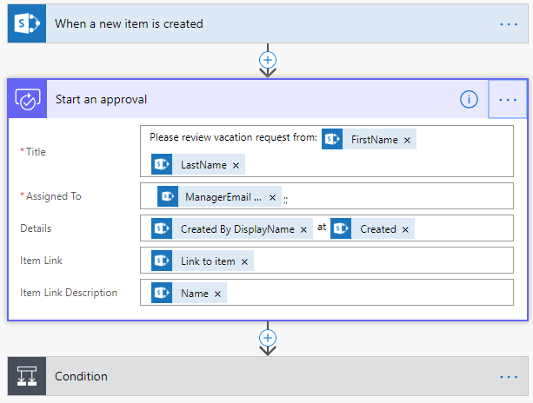
Approval Flows
What is an Approval Flow?
Quickly and easily manage the approval of documents or processes across services
Easily incorporates O365 users and groups

Slide 27
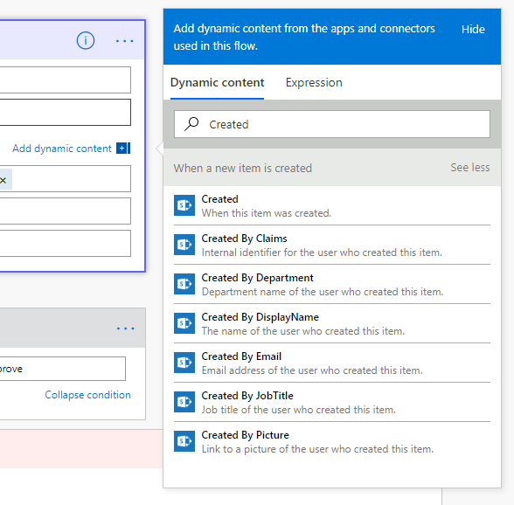
Creating an Approval Flow
Approval Flows are Flexible
Can be used in a multitude of design patterns & placed anywhere
Approvals will pause the flow, waiting on response.
Can access Items, Expressions, & Variables in Dynamic Content field

Slide 28
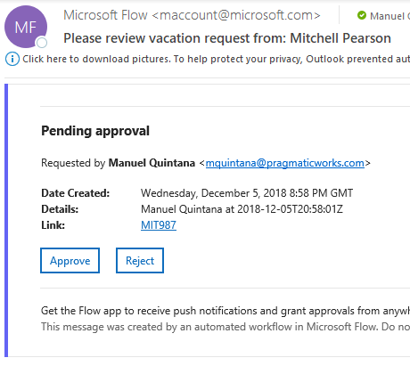
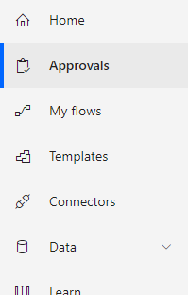
Interacting with Approval Requests
Can Interact with Approval Requests via multiple interfaces:
Email Web Mobile App

Slide 29
Getting Started with Flow Creating a Flow Using a Template Creating a Flow from Scratch
Demonstration

